Slide 1
Spine Toolbox and SpineOpt.jl for detailed sector modelling, including infrastructure
Juha Kiviluoma
2-3.12.2021 EFECT workshop on Sustainable Infrastructure and Energy Commodities for Sector Integration
Mikael Amelin, Erik Delarue, Jody Dillon, Jiangyi Huang, Maren Ihlemann, Iasonas Kouveliotis-Lysikatos, Manuel Marin, Terence O’Donnel, Ciara O’Dwyer, Fabiano Pallonetto, Kris Poncelet, Topi Rasku, Erkka Rinne, Pekka T. Savolainen, Antti Soininen, Lennart Söder, Per Vennström

Slide 2
Energy system model
Toolbox plug-ins
Plug-ins
Create / connect
SpineOpt.jl
Create / connect
Interfaces to link with tabular data
From data directly to Julia/JuMP
Exporter
Importer
SpineInterface.jl
SpineToolbox.py
Workflow tool
SQL Data Store
SpineDB_API
Data and data structure
Create your own
Plug-in: tool specification
Execution engine (parallelize scenarios and workflows)
Spine Engine

Slide 3
Spine data structure is very flexible
Object Class
Unit
Node
Object
Coal Unit 1
Electricity
CCGT Unit 2
Natural Gas
Relationship Class
unit__from_node
Relationship
unit__from_node
Natural Gas
CCGT Unit 2
Parameter definition
Parameter value
number_of_units = 1
online_variable_type = integer
CCGT Unit 2
number_of_units
online_variable_type
Unit

Slide 4
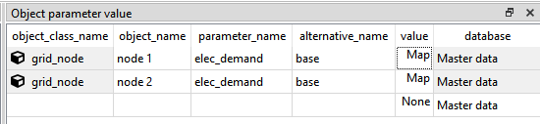
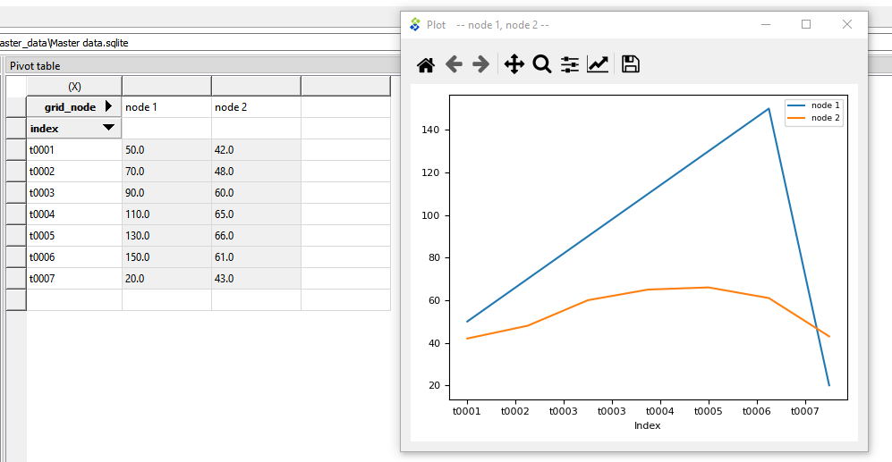
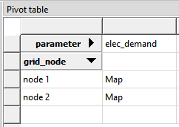
Time series / array data

Slide 5
SpineOpt.jl
Written in Julia JuMP
Investments and operations
MIP or LP
Adaptable as will be shown…
Part of the adaptiblity thanks to Spine Toolbox and SpineInterface.jl

Slide 6
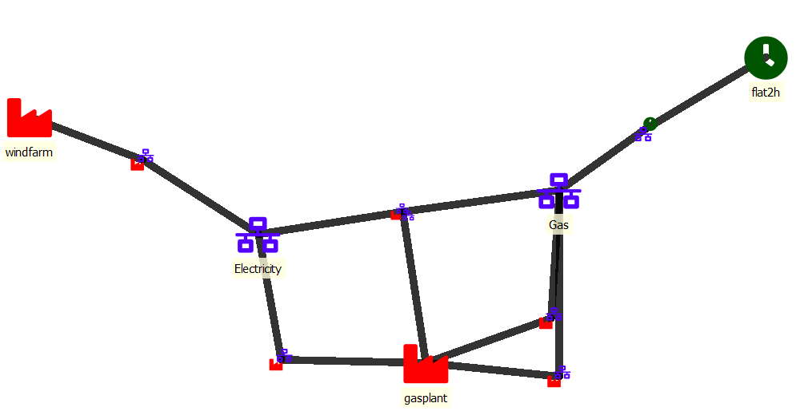
Spatially changing temporal resolution

Slide 7
Temporally changing temporal resolution
Model Horizon Hour | 1 | 2 | 3 | 4 | 5 | 6 | 7 | 8 | 9 | 10 | 11 | 12 | 13 | 14 | 15 | 16 | 17 | 18 | 19 | 20 | 21 | 22 | 23 | 24 | 25 | 26 | 27 | 28 | 29 | 30
Window 1 | 1h | 1h | 1h | 1h | 1h | 1h | 3h |  |  | 3h |  |  | 3h |  |  | 3h |  |  | 6h
 | Temporal Block 1 |  |  |  |  |  | Temporal Block 2 |  |  |  |  |  |  |  |  |  |  |  | Temporal Block 3
Window 2 | 1h | 1h | 1h | 1h | 1h | 1h | 1h | 1h | 1h | 1h | 1h | 1h | 3h | 3h | 3h | 3h | 6h
 | Temporal Block 1 |  |  |  |  |  | Temporal Block 1 |  |  |  |  |  | Temporal Block 2 |  |  |  | Temporal Block 3
Roll-forward duration
(retained solution)
optimisation window

Slide 8

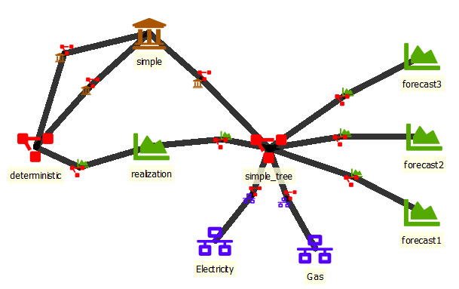
Different stochastic structures in same model
Stage 2
Stage 1

Slide 9


Sample Simple Conventional Technology
Production cost
Infinite supply
Demand timeseries
Gas
OCGT
Electricity
Production cost
CO₂
NO_{x}
Fixed demand
FRR
Fixed demand
Inertia

Slide 10

Modelling commodity networks with specific physics (Electricity)
TL3-1
E1
TL1-2
E2
TL3-6
E6
TL1-2
TL5-6
Gas
OCGT
E7
TL7-3
E3
TL3-4
E4
TL4-5
E5
Network physics = ptdf-based dc load flow
CO₂
Coal 1
Coal
NO_{x}
FRR

Slide 11
Network physics
Gas network
Electricity network
Electricity
CO₂
SMRP
NO_{x}
H2 Storage
Fuel Cell
FRR
Inertia
Electrolyser

Slide 12
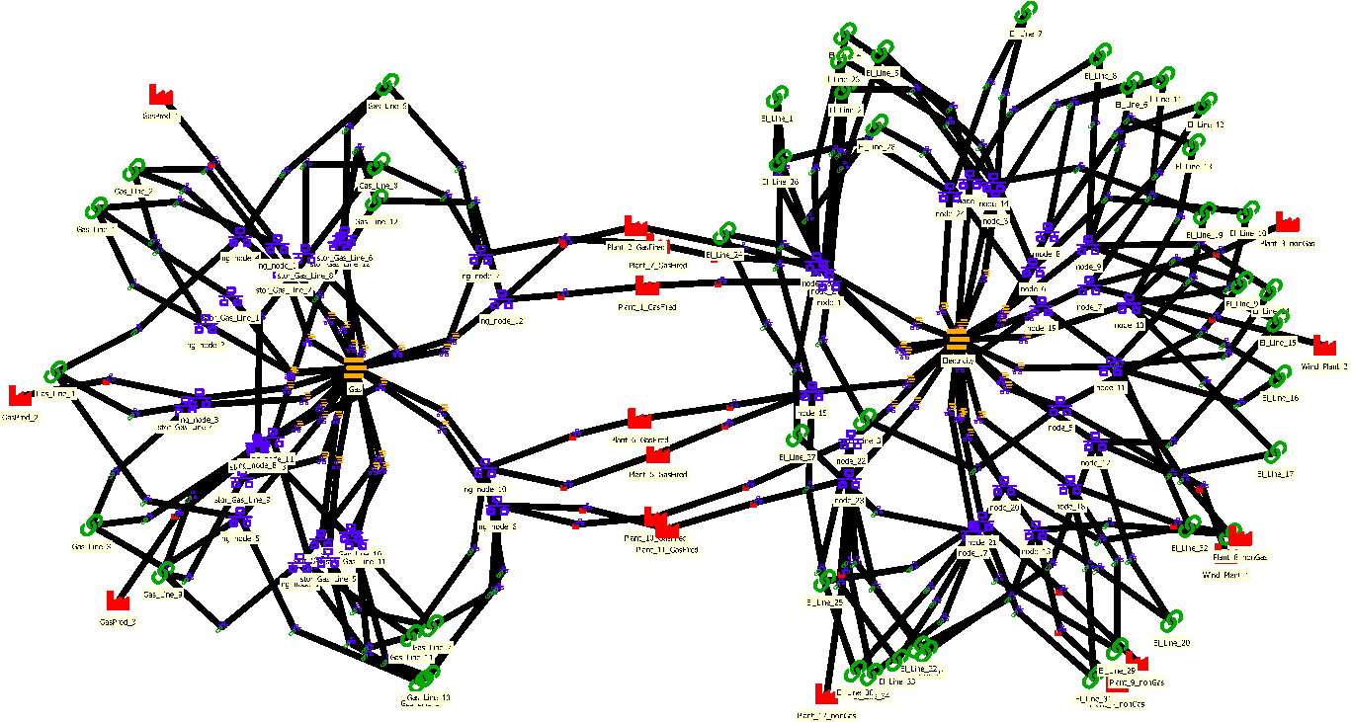
Gas Grid: Implementation
Gas network
Gas-fired
power plants
Electricity network

Slide 13
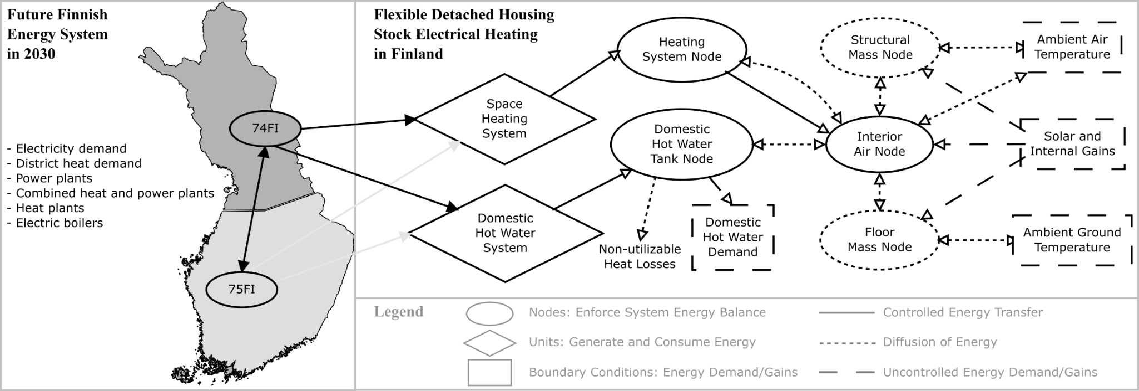
Building heating: Modelled system
Notes:
First the large-scale energy system, then the building stuff.
Lumped-capacitance thermal model of an “average building”.
Building divided into a limited number of temperature nodes depicting the average temperature in different parts of the building.
Subject to external conditions like DHW demand, ambient temperatures, and internal/solar gains.
Heating systems convert electricity into heat for the interior air node.

Slide 14

Cascading river systems using connection delays
Water infill
connection delay
connection delay
Water Storage 1
Waterway 1-2
Water Storage 2
Waterway 2-3
Water Storage 3
Hydro 3
Electricity
Hydro 1
Hydro 1
FRR
Inertia

Slide 15
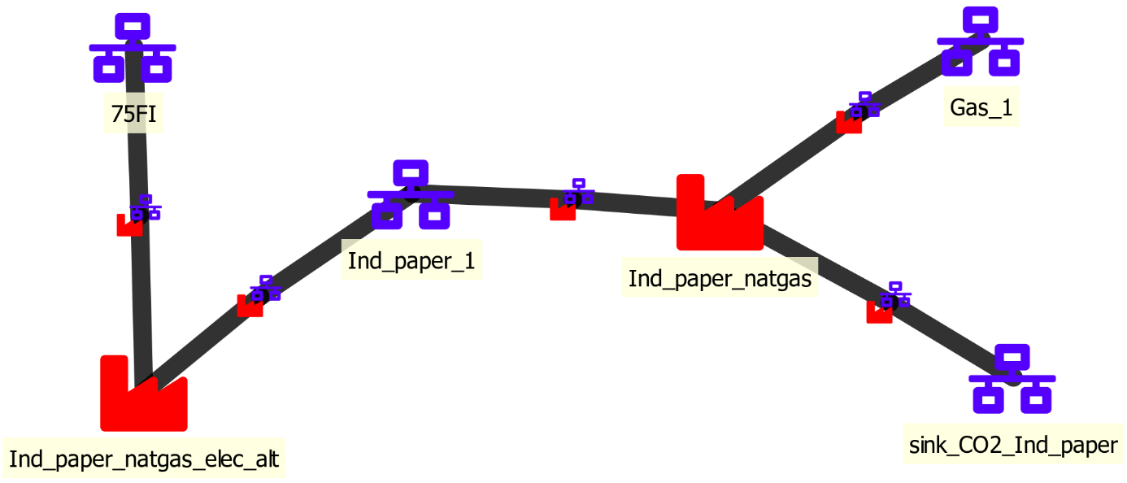
Industrial processes (paper and pulp as an example)

Slide 16
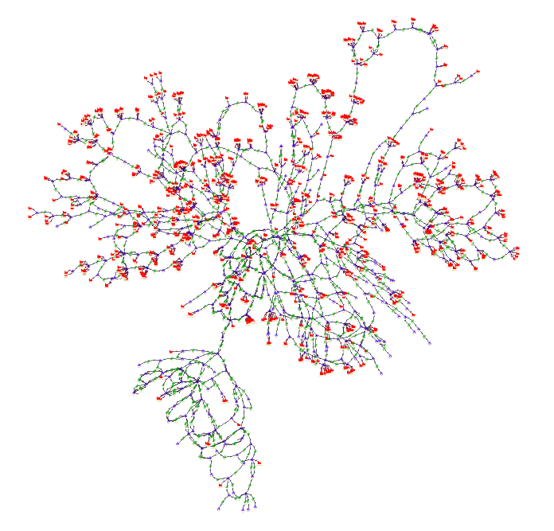
Power grid investments
The N490 model ported into Spine, with nodes in blue, generating units in red, and connections in green.*
https://github.com/Spine-project/spine-cs-c2
* Not the actual node geographical locations

Slide 17
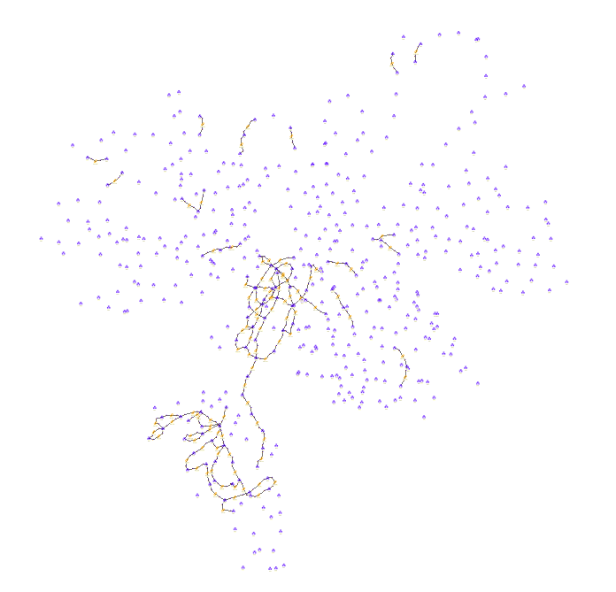
Power grid investments
The N490 model with candidate connections in dark yellow, computed as the 100 most “congested” connections from the operation run

Slide 18
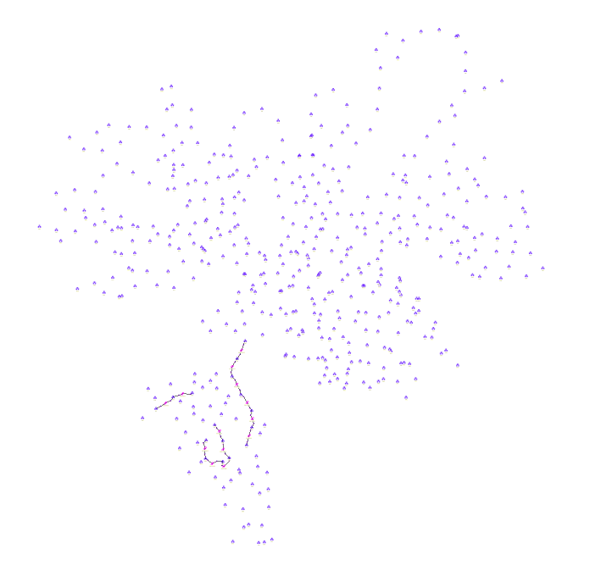
Power grid investments
The N490 model with the 14 invested connections in pink, as determined by the investment run. The model converges after two Benders iterations, about 6 hours of wall time

Slide 19
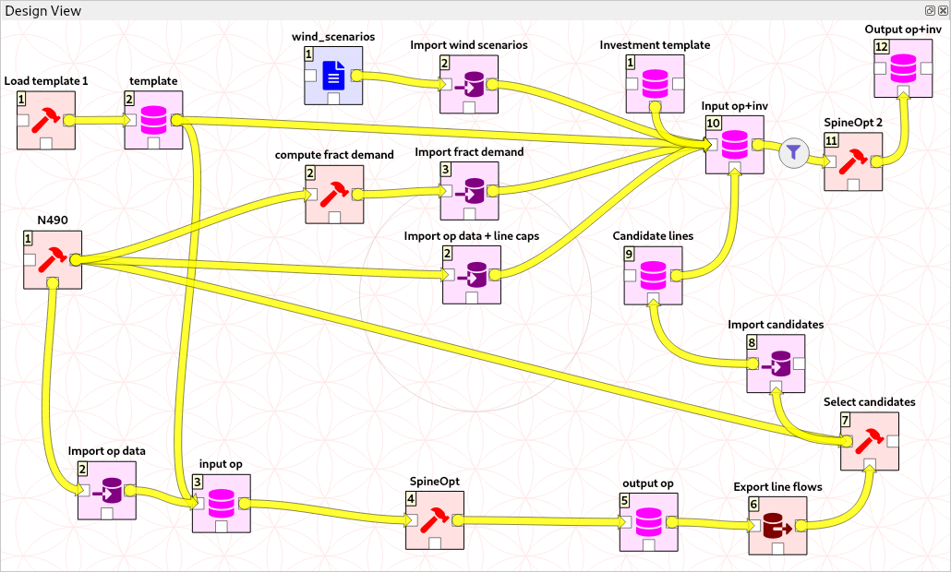
Power grid investments: Implementation
Run SpineOpt with operation & investment data
Import N490 data into a SpineOpt DB (including the template)
Import N490 data (with line capacities), wind scenarios, and candidate lines into a SpineOpt DB
Run SpineOpt with operation data
Use results from operation run to select candidate lines

Slide 20






Pre-prints:
http://www.spine-model.org/publications.htm
Longer webinars:
https://youtube.com/playlist?list=PLnepL-H6Msr_XjSMnHhlnhJbuzYbPHsRR
Repositories:
https://github.com/Spine-project
(includes documentation and case studies as examples)
Project is over
Development is continuing in the repositories
Welcome to join! Or, if you like them, give GitHub stars
This project has received funding from the European Union’s Horizon 2020 research and innovation programme under grant agreement N. 774629.

Slide 21
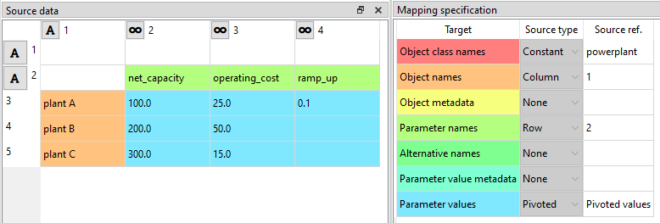
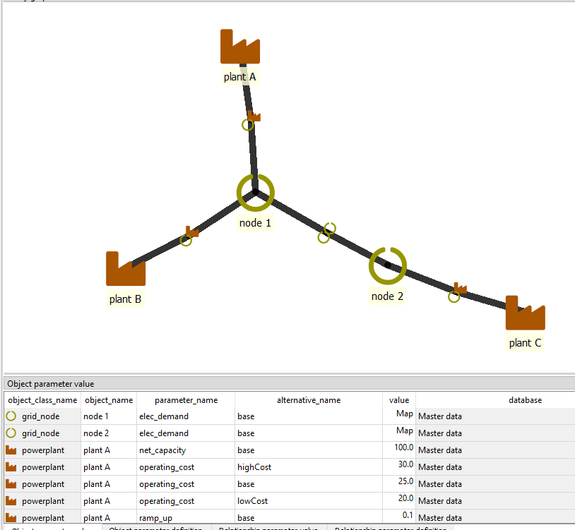
Importer and exporter
csv
xlsx
gdx
sql
…modular

Slide 22
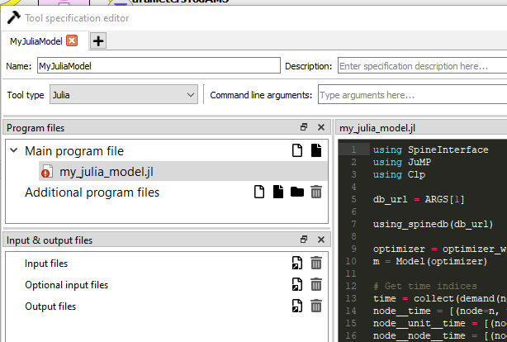
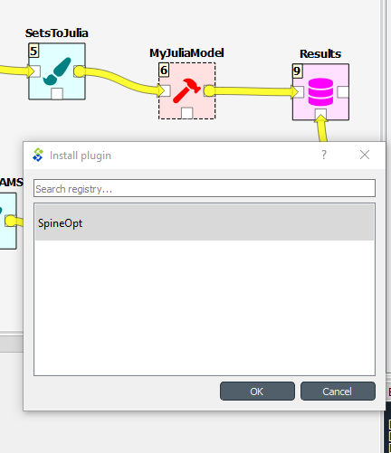
Plug-in
Tool specification
Tool instance

